Slide 1
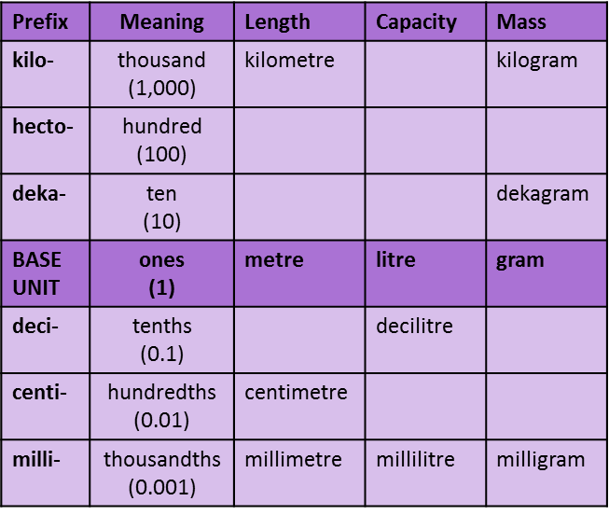
Year 7 Mathematics Knowledge Organiser – Multiplicative reasoning
KS4 Mathematics Knowledge Organiser – Percentages – Part 1
Length is the distance of something measured.
Capacity how much something can hold (generally liquid), commonly known as VOLUME
Mass is a measure of how much matter is in an object, commonly known as WEIGHT.
The Imperial system is a system of weights and measures originally developed in England. It consists of many different units of measurement, which are named differently and have different conversion factors.
The Metric system is a system of measurement that uses the meter, litre, and gram as base units of length (distance), capacity (volume), and weight (mass) respectively.
CONVERTING BETWEEN IMPERIAL AND METRIC UNITS
LENGTH
1 inch ≈ 2.5 cm 1 foot ≈ 30 cm
1 yard ≈ 0.9 metre
1 mile ≈ 1.6 km
Example: Estimate a length of half a metre in inches?
Half a metre is 50 cm.
1 inch ≈ 2.5 cm.
50 ÷ 2.5 ≈ 20inches
CAPACITY / VOLUME
1 pint ≈ 0.6 litres (l)
1 litre (l) ≈ 1.75 pints (pt)
1 gallon ≈ 4.5 litres.
Example: How many litres are in 8 gallons of petrol?
1 gallon ≈ 4.5 litres
8 gallons = 8 × 4.5 = 36 l
MASS / WEIGHT
1 kilogram (kg) ≈ 2.2 pounds (lb).
1 pound (lb) ≈ half a kilogram.
1 stone (st) ≈ 6.5 kilograms (kg).
Example: Estimate a mass of 7 pounds (lb) in kilograms (kg).
1 pound (lb) ≈ half a kilogram. 7 lb = 0.5 × 7 = 3.5 kg
To convert from pounds to kg: divide by 2.2.
÷ 2.2
1kg ≈ 2.2 pounds
× 2.2
To convert from kg to pounds: multiply by 2.2.
gallon | 1 | 2 | 8
litre | 4.5 | 9 | 36
pound | 1 | 2 | 6 | 7
kg | 0.5 | 1 | 3 | 3.5
inch | 1 | 2 | 20
cm | 2.5 | 5 | 50
×2
×4
×2
×3
×2
×10
CONVERTING METRIC UNITS
LENGTH - basic unit is metre (m)
1 cm = 10 mm
1 m = 100 cm
1 km = 1000 m
Example: Convert 3 m to millimetres.
3 m = 300 cm = 3000 mm
CAPACITY - basic unit is litre (l)
1 l = 1000 ml
Example: Convert 5700 ml to litres.
5700 ml = 5.7 l
MASS - basic unit is gram (g)
1 g = 1000 mg
1 kg = 1000 g
1 t = 1000 kg
Example: Convert 8700 mg to kilograms.
8700 mg = 8.7 g = 0.0087 kg
÷ 1000
× 100
× 10
÷ 1000
÷ 1000

Slide 2
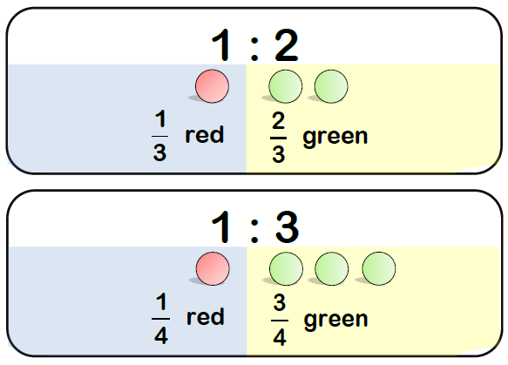
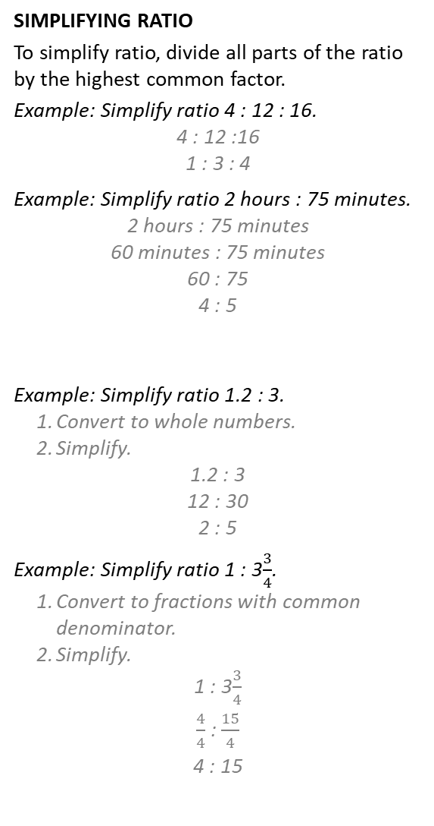
Year 7 Mathematics Knowledge Organiser – Multiplicative reasoning
A ratio shows the relative sizes of two or more values.
SIMPLIFYING RATIO
To simplify ratio, divide all parts of the ratio by the highest common factor.
Example: Simplify ratio 4 : 12 : 16.
4 : 12 :16
1 : 3 : 4
Example: Simplify ratio 2 hours : 75 minutes.
2 hours : 75 minutes
60 minutes : 75 minutes
60 : 75
4 : 5
Example: Simplify ratio 1.2 : 3.
Convert to whole numbers.
Simplify.
1.2 : 3
12 : 30
2 : 5
Example: Simplify ratio 1 : 3$\frac{3}{4}$.
Convert to fractions with common denominator.
Simplify.
1 : 3$\frac{3}{4}$
$\frac{4}{4}$ : $\frac{15}{4}$
4 : 15
SHARING IN THE RATIO
A ratio can also be used to share a quantity into parts.
Example: Share 30 sweets into a ratio of 2 : 3.
Total amount of parts = 2 + 3 = 5.
If 30 sweets are shared equally in 5 parts, each part contains 30 ÷ 5 = 6 sweets.
2 : 3
12 : 18
RELATIONSHIP BETWEEN RATIO AND PROPORTION
RATIO is a part to part comparison.
PROPORTION is a part to whole comparison.
Proportions can be expressed as fractions or percentages.
Example: To make the colour I need for my painting I mix the blue and red paint in the ratio 3 : 7. What fraction is blue paint? What percentage is red paint?
Blue paint is represented by 3 parts out of 10, therefore the proportion of blue paint is $\frac{3}{10}$.
The rest of the paint is red = $\frac{7}{10}$, so the red paint makes 70% of the whole paint.
÷4
÷4
convert to the same units
6 | 6 | 6 | 6 | 6
÷15
÷15
no more using the units
×6
×6
Example: Alison and Henry shared some money in a ratio of 3 : 5. Henry got £10 as a result. How much money did they share?
Total amount of parts = 3 + 5 = 8.
If Henry received £10, this amount is shared in 5 parts. One part is worth 10 ÷ 5 = £2.
Therefore Alison received 3 × £2 = £6.
They shared £10 + £6 = £2 × 8 = £16.
3 : 5
? : 10
6 : 10
×10
×10
÷6
÷6
 |  |  | 2 | 2 | 2 | 2 | 2
2 | 2 | 2 | 2 | 2 | 2 | 2 | 2
common denominator
×2
×2
×4
×4

Slide 3
Year 7 Mathematics Knowledge Organiser – Multiplicative reasoning
SOLVING SIMPLE DIRECT PROPORTION WORD PROBLEMS
Two quantities are said to be in DIRECT PROPORTION if they increase or decrease at the same rate. That is, if the ratio between the two quantities is always the same.
Example: The cost of 6 apples is £1.50. What is the cost for 9 apples? What would be the cost of 5 apples?
USING UNITARY METHOD
Using unitary method means find the value of 1 part.
Example: Write the ratio 5 : 8 in the form 1 : m and n : 1.
1 : m
5 : 8
1 : 1.6
n : 1
5 : 8
0.625 : 1
÷5
÷5
÷8
÷8
÷6
×5
unitary ratios can include decimals
apples | 6 | 3 | 9 | 1 | 5
cost | £1.50 | £0.75 | £2.25 | £0.25 | £1.25
BEST BUYS
We can compare the value of products using the UNITARY METHOD, either through
the cost per unit amount, or
the amount per unit cost.
Example: Kayden buys an ice cream from Mr Whipcream. He gets 200ml of ice cream for £1.50. Lilly buys an ice cream from Iced Delights. She gets 300ml of ice cream for £2.40.
Who gets better value for money?
Cost per unit amount method:
Mr Whipcream: 1.50 ÷ 200 = £0.0075 per ml
Iced Delights: 2.40 ÷ 300 = £0.008 per ml
Mr Whipcream is cheaper per ml, therefore better value for money.
Amount per unit cost method:
Mr Whipcream: 200 ÷ 1.50 = 133.33 ml per £
Iced Delights: 300 ÷ 2.40 = 125 ml per £
Mr Whipcream gives more ice cream per £, therefore better value for money.
÷2
×3
6 apples cost £1.50
3 apples cost £0.75
9 apples cost £2.25
÷2
6 apples cost £1.50
1 apple cost £0.25
5 apples cost £1.25
÷2
÷6
÷6
×3
×3
×5
×5
SOLVING SIMPLE INVERSE PROPORTION WORD PROBLEMS
Two quantities are said to be INVERSELY PROPORTIONAL if, as one quantity increases, the other quantity decreases at the same rate.
Example: I want to build a wall in my garden. 2 builders would do it in 108 hours. How long would it take 9 builders to build the wall?
£1.50 : 200 ml
£0.0075 : 1 ml
£2.40 : 300 ml
£0.008 : 1 ml
÷2
×9
builders | 2 | 1 | 9
hours | 108 | 216 | 24
×2
÷9
£1.50 : 200 ml
£1 : 133.33 ml
£2.40 : 300ml
£1 : 125 ml
÷2
2 builders 108 hours
1 builder 216 hours
9 builders 24 hours
×2
×9
÷9

