Slide 1

Trigonometry
Finding the side which is the denominator of the fraction
Click here
for audio

Slide 2
First you need to check your calculator is set to degrees
Look at the top of the calculator display, you should see a . If so all is fine.
If you don’t, you’ll see either an or a . You need to see for degrees.
Here are some instructions to get your calculator onto degrees.
D
R
G
D
Press the following buttons on your calculator
Click here
for audio
Shift
Menu setup
1 : Input/Output
You will see 2 : Angle Unit. Press
2
You will see 1 : Degree Press
1
3 : Number Format
2 : Radian
4 : Engineer Symbol
3 : Gradian
Now you should see a at the top of your calculator display
D

Slide 3

The Sine, Cosine and Tangent ratios (Sin, Cos and Tan)
H
O
This just summarises
the triangle and
Sin, Cos and Tan.
This explains what is meant
by finding the denominator.
Important you listen to this.
$$θ$$
A
$$Sinθ=\frac{Opposite}{Hypotenuse}$$
$$Cosθ=\frac{Adjacent}{Hypotenuse}$$
$$Tanθ=\frac{Opposite}{Adjacent}$$
$$Sinθ=\frac{O}{H}$$
$$Cosθ=\frac{A}{H}$$
$$Tanθ=\frac{O}{A}$$

Slide 4




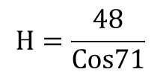




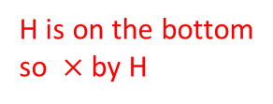

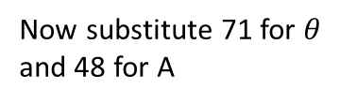

Find the side length $x.$
Write out SOH CAH TOA and tick off the side
we know and the one we are trying to find. So
here, A and H.
SOH CAH TOA
$$x$$
$$x$$
H
O
So we are going to use Cosine
$$Cosθ=\frac{A}{H}$$
Now substitute 71 for $θ$
and 48 for A
71
71
$$Cos71=\frac{48}{H}$$
H is on the bottom
so $×$ by H
A
48cm
48cm
$$H×Cos71=48$$
Now divide by Cos71
$$H=\frac{48}{Cos71}$$
or type
Now type this into
your calculator. You
can use the fraction
button if you like
4
8
$$×$$
1
$$÷$$
Cos
7
858
$$=$$
$$x=147.4 cm$$
Click here
for audio

Slide 5


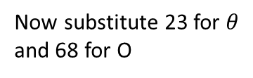


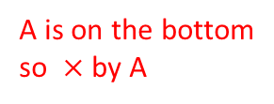

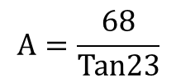
Find the length of side ML
Write out SOH CAH TOA and tick off the side
we know and the one we are trying to find. So
here, O and A.
M
M
$$x$$
A
L
L
23
23
SOH CAH TOA
68cm
68cm
O
H
So we are going to use Tangent
$$Tanθ=\frac{O}{A}$$
Now substitute 23 for $θ$
and 68 for O
K
K
$$Tan23=\frac{68}{A}$$
A is on the bottom
so $×$ by A
$$A×Tan23=68$$
Now divide by Tan23
Click here
for audio
$$A=\frac{68}{Tan23}$$
or type
Now type this into
your calculator. You
can use the fraction
button if you like
6
8
$$×$$
3
$$÷$$
Tan
2
858
$$=$$
$$x=160.2 cm$$

Slide 6




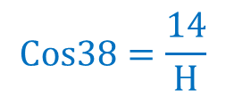
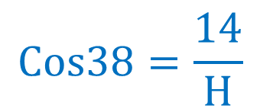
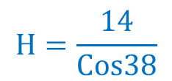
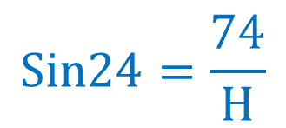

$$Cos38=\frac{14}{H}$$
For example
First you $×$ by H
So here there
are two steps
$$H×Cos38=14$$
Second you $÷Cos38$
$$H=\frac{14}{Cos38}$$
Click here
for audio
$$H=17.8cm$$
$$Sin24=\frac{74}{H}$$
$$Cos38=\frac{14}{H}$$
$$Tan34=\frac{23}{A}$$
For these problems you will be finding
the side which is on bottom

Slide 7
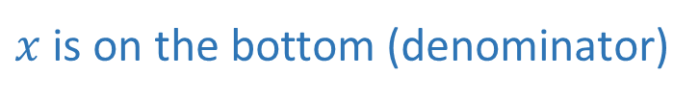
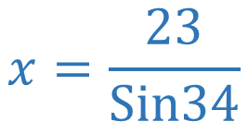
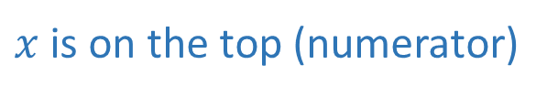






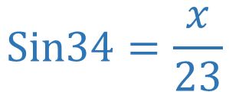
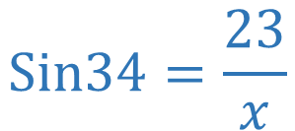

Summary for finding a side – two possible methods
$x$ is on the top (numerator)
$x$ is on the bottom (denominator)
One step
Two steps
$$Sin34=\frac{x}{23}$$
One step $×$ by $23$
$$Sin34=\frac{23}{x}$$
1st step $×$ by $x$
$$x=23×Sin34$$
$$x×Sin34=23$$
2nd step $÷Sin34$
$$x=\frac{23}{Sin34}$$
$$x=12.9 cm$$
Click here
for audio
$$x=41.1 cm$$

