Slide 1
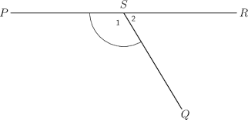
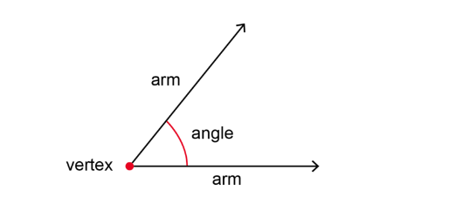
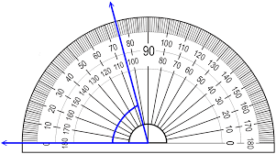
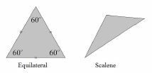
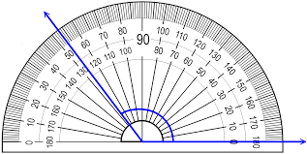
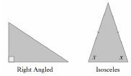
KS4 Mathematics Knowledge Organiser – Algebra – Part 1
Year 7 Mathematics Knowledge Organiser – Angles
KS4 Mathematics Knowledge Organiser – Percentages – Part 1
An ANGLE is the amount of turn between two straight lines joined (or intersected) at a point called a VERTEX. The two lines are called arms.
Angles are commonly marked by an arc (part of a circle) between arms.
x
Angles are labelled using one lower case letter or three upper case letters, in which case the letter in the middle always represents the vertex.
Example: Angle x is labelled as ∠PSQ or ∠QSP
PARALLEL LINES are lines that never cross each other - they keep the same distance apart from each other. They are marked with arrows.
Lines that cross (intersect) each other at right angles (90°) are called PERPENDICULAR LINES.
TYPES OF ANGLES
ANGLES AROUND THE POINT
Angles at a point add up to 360°.
Example: Find the missing angle x.
x = 360 – (98 + 35 + 90) = 360 - 223
x = 137°
ANGLES ON THE STRAIGHT LINE
Angles on a straight line add up to 180°.
Example: Find the missing angle x.
x = 180 – (38 + 81) = 180 - 119
x = 61°
An ACUTE ANGLE is less than 90°.
A RIGHT ANGLE is exactly 90°.
An OBTUSE ANGLE is greater than 90° but less than 180°.
A REFLEX ANGLE is greater than 180° but less than 360°.
MEASURING ANGLES
TRIANGLES
Right Angle Triangles have a 90° angle in.
Isosceles Triangles have 2 equal sides and 2 equal base angles.
Equilateral Triangles have 3 equal sides and 3 equal angles (60°).
Scalene Triangles have different sides and different angles.
ANGLES IN THE TRIANGLE
Angles in the triangle add up to 180°.
Example: Find the missing angle w.
w = 180 – (72 + 51) = 180 - 123
w = 57°
Example: Find the missing angle k.
a = 180 – 130 = 50°
b = 180 – 85 = 95°
w = 180 – (50 + 95) = 180 - 145
w = 35°
Place the midpoint of the protractor on the VERTEX of the angle.
Line up one arm of the angle with the zero line of the protractor (where you see the number 0).
Read the degrees where the other arm crosses the number scale.
127°
74°
(angles on the straight lines)
a
b

Slide 2
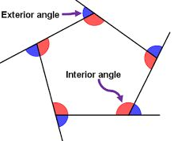
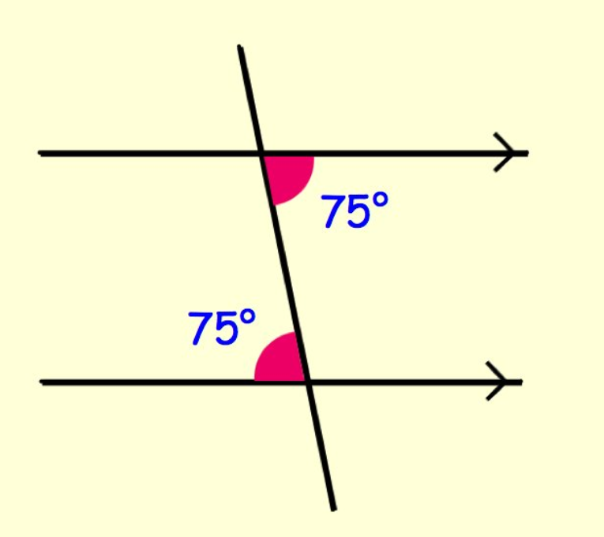
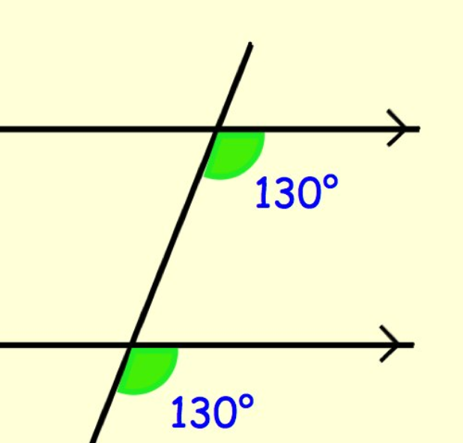
KS4 Mathematics Knowledge Organiser – Algebra – Part 1
Year 7 Mathematics Knowledge Organiser – Angles
KS4 Mathematics Knowledge Organiser – Percentages – Part 1
QUADRILATERALS
ANGLES IN THE POLYGONS (a polygon is a 2-D shape made of straight lines)
The sum of the interior angles of a polygon of $n$ sides is found by the formula
$$(n−2)×180$$
The sum of the exterior angles of a polygon is always 360⁰.
Interior and exterior angles in polygons add up to 180°.
Regular polygon with n sides
In a regular polygon all sides and angles are equal.
In a regular polygon, the size of one interior angle is equal to $\frac{sum}{n}=\frac{(n−2)×180}{n}$
In a regular polygon, the size of one exterior angle is equal to $\frac{360}{n}$
(n-2) represents min. number of triangles, each
n-sided polygon can be divided into
ANGLES IN THE QUADRILATERAL
Angles in the quadrilateral add up to 360°.
Example: Find the missing angle CDA.
∠ CDA = 360 – (111 + 129 + 68)
= 360 – 308 = 52°
ANGLES IN PARALLEL LINES
When a transversal (a line that crosses at least two other lines) intersects parallel lines, angles with special properties are created.
Example: Find interior and exterior angles in a regular pentagon.
Pentagon can be divided into 3 triangles, so sum of interior angles = (5 – 2) × 180
= 3 × 180 = 540°
In regular pentagon, each interior angle = 540 ÷ 5 = 108°
Sum of exterior angles = 360°, so each ext. angle in regular pentagon = 360 ÷ 5 = 72°
VERTICALLY OPPOSITE ANGLES
Vertically opposite angles are equal.
Alternate angles are equal
Corresponding angles are equal
Co-interior angles sum to 180º
Example:

