Slide 1
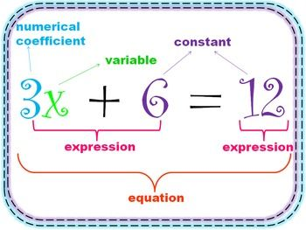
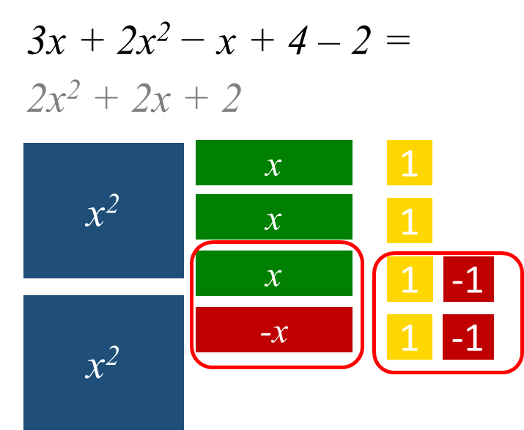
KS4 Mathematics Knowledge Organiser – Algebra – Part 1
Year 7 Mathematics Knowledge Organiser – Basic Algebra
KS4 Mathematics Knowledge Organiser – Percentages – Part 1
A variable is a letter or symbol that represents an unknown value.
When variables are used with other numbers, parentheses, or operations, they create an algebraic expression.
Equation is algebraic expression with equal sign, which can be solved (value of variable is found).
A coefficient is the number multiplied by the variable in an algebraic expression.
A term is the name given to a number, a variable, or a number and a variable combined by multiplication or division, including + or – symbol in front of it.
A constant is a number that cannot change its value.
Identity is an equation that is true no matter what values are chosen. (symbol ≡)
A formula is an equation linking sets of physical variables.
SIMPLIFYING EXPRESSIONS
Multiplication of a number and variable is written without multiplication symbol, numbers first, letters in alphabetical order:
Example: 3 × x = 3x
y × 6 × x = 6xy
Division is written as a fraction:
Example: 6 ÷ x = $\frac{6}{x}$
Multiplying and dividing variables
Example: x × x × x = x³
2 × x × y × 3 =
2 × 3 × x × y = 6xy
6x ÷ 2 = 3x
COLLECTING LIKE TERMS
‘Like terms’ are terms whose variables (and their powers) are the same, the coefficients can be different.
Example:
x + x + 2x = 4x
x + 4 + 3x - 5 = 4x -1
x + 3y + 2x - 2y + 3 = 3x + y + 3
9x² − 2x − 5x² - 5x = 4x² – 7x
WRITING EXPRESSIONS AND EQUATIONS
The word phrases can be translated into algebraic expressions or equations with variables.
Examples:
Eight less than the quotient of a number and two
$\frac{x}{2}−8$
Nine times the sum of a number and fifteen
9(n + 15)
The sum of twice a number and seven
2x + 7
One plus the product of a number and five
1 + 5x
A number less than twenty-five
25 - x
I think of a number (x). When I multiply the number by two (2x) and add 3 (2x + 3), the answer is 11
2x + 3 = 11
I think of a number (x). When I add 3 (x+3) and multiply the result by 2 (2(x + 3)), the answers is 11
2(x+3) = 11
Task2: Write an equation: I think of a number. When I add 7 and divide the result by 2, the answers is 5.
Task1: Simplify 2x² + xy + 3x² + xy=

Slide 2
KS4 Mathematics Knowledge Organiser – Algebra – Expanding and factorising– Part 1
Year 7 Mathematics Knowledge Organiser – Basic algebra
KS4 Mathematics Knowledge Organiser – Percentages – Part 1
Expanding brackets means to remove the brackets.
Factorising means putting brackets back into expressions.
Factors of a number are the numbers that divide the original number without remainder.
Writing a number as a product of factors is called a factorisation of the number.
The Highest Common Factor (HCF) is the largest common factor (the factor that two or more numbers have in common).
WRITING FORMULAE
Example:
Guy, Eric and Luke go Christmas shopping.
Write an expression for how much money each man has left after shopping.
Guy had £20 and spends £y on presents.
20-y
(b) Eric had £m and spends £12 on presents.
m-12
(c) Luke had £a and spends half £b on presents
a - $\frac{1}{2}$b
Adult tickets to the cinema cost £7. Child tickets cost £4. Write an expression for the total cost of taking a adults and c children to the cinema. 7a + 4c
A phone company charges a monthly fee of £10.25 and £0.12 per minute. Write a formula for the monthly bill, b for m minutes.
b = 10.25 + 0.12m
EXPANDING SINGLE BRACKETS
Multiply everything in the brackets by a number or variable in front of the bracket
Examples: Expand
4(a + 6) = 4a + 24
-2(b – 4) = -2b + 8
c(2c – 5) = 2c² – 5c
2d(3d – e) = 6d²-2de
SUBSTITUTION
If we are told what number a variable represents, we can substitute this into expressions to find their value.
Examples:
Find the value of expressions when x = 5, y = 4
7x = 7× 5 = 35
3(x + 1) = 3 × (5 + 1) = 3 × 6 = 18
$\frac{2(x−1)}{4}$ = $\frac{2(5−1)}{4}$ = $\frac{2×4}{4}$ = $\frac{8}{4}$ = 2
x² = 5² = 25
2x² = 2× 5² = 2 × 25 = 50
(2x)² = (2 × 5)² = 10² = 100
xy = 5 × 4 = 20
FACTORISING
Find the HCF of the terms in the brackets (highest number and the highest power of the variable)
Put the HCF in front of the brackets
Check your answers by expanding brackets
Examples: Factorise
4x + 12 = 4(x + 3)
7x² + 3x = x(7x + 3)
8x² + 16x = 8x(x + 2)
Answers:
5x² + 2xy
$\frac{x+7}{2}=5$
C = 2k + 0.5
-4x + 6
3x² + 3x
3(x – 2)
2x(2x + 3)
3× 2 – 1 = 5
Task4: Expand -2(2x -3)
Task5: Expand 3x(x + 1)
Task6: Factorise 3x - 6
Task7: Factorise 4x² + 6x
Task8: Find the value of expression 3x – 1 when x = 2
Task3: A delivery company charges according to the weight of each parcel.
They charge £2 per kilogram, plus 50p handling fee. Write an expression for the cost C of sending a parcel that weighs k kilograms.

