Slide 1
KS4 Mathematics Knowledge Organiser – Algebra – Part 1
Year 7 Mathematics Knowledge Organiser – Fractions
KS4 Mathematics Knowledge Organiser – Percentages – Part 1
Fractions represent equal parts of a whole. Example:
Mixed number is a number consisting of an integer and a proper fraction. Example: $1\frac{1}{4}$
Improper fraction is a fraction in which the numerator is greater than the denominator. Example: $\frac{5}{4}$
Common denominator is a common multiple of the denominators of several fractions.
Equivalent fractions are fractions which have the same value. Example: $\frac{1}{2}$ and $\frac{2}{4}$ are equivalent fractions.
$$\frac{3}{4}$$
the numerator says how many parts we have. the denominator says how many equal parts the whole is divided into
SIMPLIFYING FRACTIONS
Divide numerator and denominator by the same factor:
Example: Simplify/cancel down $\frac{12}{30}$ fully
All of these fractions are equivalent.
CONVERTING MIXED NUMBERS TO IMPROPER FRACTIONS
Example: Convert $2\frac{3}{4}$ into improper fraction
Imagine mixed number as an addition
Change integer part into fraction
with the same denominator
Add the fractions
Different method:
ADDING AND SUBTRACTING FRACTIONS
Example: Add $\frac{2}{3}$ and $\frac{1}{2}$
Convert fractions into fractions with common denominator.
The lowest common denominator is 6
$\frac{2}{3}=\frac{4}{6}$ $\frac{1}{2}=\frac{3}{6}$
Add or subtract numerators and simplify, if needed. Always convert improper fractions into mixed numbers.
$\frac{2}{3}+\frac{1}{2}= \frac{4}{6}+\frac{3}{6}=\frac{7}{6}=1\frac{1}{6}$
To add or subtract mixed numbers, convert mixed numbers to improper fractions first, than add or subtract.
Example: Subtract $1\frac{3}{4}$ and $1\frac{1}{2}$
$$1\frac{3}{4}−1\frac{1}{2}=\frac{7}{4}−\frac{3}{2}=\frac{7}{4}−\frac{6}{4}=\frac{1}{4}$$
÷2
÷3
$2\frac{3}{4}$
$$\frac{12}{18}= \frac{6}{9} = \frac{2}{3}$$
$$2\frac{3}{4}=2+\frac{3}{4}$$
÷2
÷3
$$2+\frac{3}{4}=\frac{8}{4}+\frac{3}{4}$$
$$\frac{12}{18}$$
$$\frac{6}{9}$$
$$\frac{2}{3}$$
$$2\frac{3}{4}=\frac{8}{4}+\frac{3}{4}=\frac{8+3}{4}=\frac{11}{4}$$
+
+
ORDERING FRACTIONS
Convert fractions into equivalent fractions with the lowest common denominator and compare.
Example: Put these fractions in ascending order $\frac{2}{3}$, $\frac{3}{5}$, $\frac{1}{2}$
The lowest common multiple of 3, 5, and 2 is 30
$\frac{2}{3}=\frac{20}{30}$, $\frac{3}{5}=\frac{18}{30}$, $\frac{1}{2}=\frac{15}{30}$
The correct order is: $\frac{1}{2}$, $\frac{3}{5}$, $\frac{2}{3}$
$$2\frac{3}{4}=\frac{\left(4×2\right)+3}{4}=\frac{8+3}{4}=\frac{11}{4}$$
×
CONVERTING IMPROPER FRACTIONS TO
MIXED NUMBERS
Example: Convert $\frac{11}{4}$ into improper fraction
Divide numerator by denominator
The answer is the integer part
and the remainder is the numerator
of fractional part
Denominator stays the same
11 ÷ 4=2 r3
converting into improper fractions
common denominator
$2\frac{3}{4}$

Slide 2
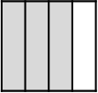
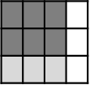
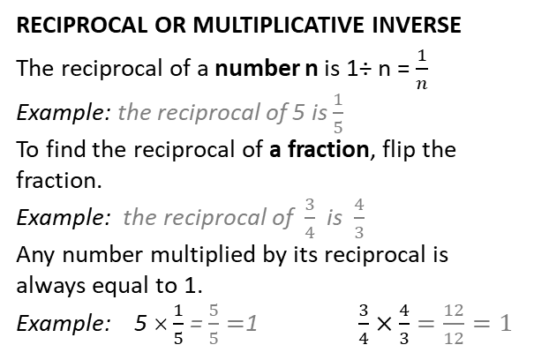
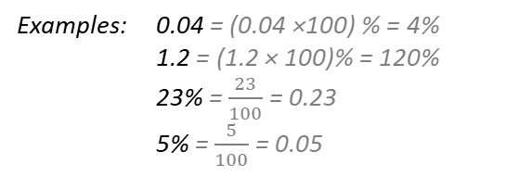

KS4 Mathematics Knowledge Organiser – Algebra – Part 1
Year 7 Mathematics Knowledge Organiser – Fractions
KS4 Mathematics Knowledge Organiser – Percentages – Part 1
MULTIPLYING FRACTIONS
Multiply numerators and denominators separately and simplify the answer if possible.
Example: $\frac{3}{4}$ × $\frac{2}{3}$ $\frac{3}{4}$ $\frac{2}{3}$ of $\frac{3}{4}$ = $\frac{6}{12}$
$\frac{3}{4}$ × $\frac{2}{3}$ = $\frac{3×2}{4×3}$ = $\frac{6}{12}$ = $\frac{1}{2}$
To multiply fraction by the whole number, convert whole number into the fraction and multiply.
Example:
$\frac{2}{3}$ × $\frac{4}{1}$ = $\frac{2×4}{3×1}$ = $\frac{8}{3}$ = $2\frac{2}{3}$
To multiply mixed numbers, convert mixed numbers to improper fractions and multiply. Always convert the answer back to mixed number.
Example:
RECIPROCAL OR MULTIPLICATIVE INVERSE
The reciprocal of a number n is 1÷ n = $\frac{1}{n}$
Example: the reciprocal of 5 is $\frac{1}{5}$
To find the reciprocal of a fraction, flip the fraction.
Example: the reciprocal of $\frac{3}{4}$ is $\frac{4}{3}$
Any number multiplied by its reciprocal is always equal to 1.
Example: 5 × $\frac{1}{5}$ = $\frac{5}{5}=$1 $\frac{3}{4}×\frac{4}{3}=\frac{12}{12}=1$
CONVERTING BETWEEN FRACTIONS, TERMINATING DECIMALS AND PERCENTAGES
D
F
Write the decimal as a fraction ‘over one’.
Convert the fraction into a fraction with whole number in the numerator by multiplying both numerator and denominator by the multiple of 10.
Simplify.
Example: Convert 0.84 into a fraction.
0.84 = $\frac{0.84}{1}$ = $\frac{84}{100}$= $\frac{21}{25}$
×
×
$$\frac{2}{3} ×4=\frac{2}{3}+\frac{2}{3}+\frac{2}{3}+\frac{2}{3}=\frac{8}{3}=2\frac{2}{3}$$
DIVIDING FRACTIONS
To divide two fraction, multiply the first fraction by the reciprocal of the second one.
Example: $\frac{1}{2}÷\frac{1}{4}$ = $\frac{1}{2}×\frac{4}{1}$ = $\frac{4}{2}=$ $\frac{2}{1}$ = 2
Dividing fractions and whole numbers. Convert the whole number into a fraction and divide.
Example: 3 ÷ $\frac{1}{4}=\frac{3}{1}÷\frac{1}{4}=\frac{3}{1}×\frac{4}{1}=12$
$\frac{2}{5}$ ÷ 2 $=\frac{2}{5}÷\frac{2}{1}=\frac{2}{5}×\frac{1}{2}=\frac{2}{10}=\frac{1}{5}$
Dividing mixed numbers: change the mixed numbers to an improper fractions and divide.
Example: $2\frac{2}{5}$ ÷ $\frac{1}{2}=\frac{12}{5}÷\frac{1}{2}=\frac{12}{5}×\frac{2}{1}=\frac{24}{5}=4\frac{4}{5}$
F
D
Divide the numerator by denominator.
Sometimes, you can help yourself by converting the fraction into the fraction with multiple of 10 in the denominator.
Example1: Convert $\frac{2}{9}$ to decimal
2 ÷ 9 = 0.22222…..
Example2: Convert $\frac{2}{25}$ to decimal
$\frac{2}{25}=\frac{8}{100}$ 8÷ 100 = 0.08
2$\frac{1}{3}×3\frac{1}{2}=$
$\frac{7}{3}×\frac{7}{2}=\frac{7×7}{3×2}=\frac{49}{6}$ $=8\frac{1}{6}$
FRACTION OF A NUMBER
Divide a number by denominator and multiply
by numerator.
Example: Find $\frac{2}{5}$ of £80
(£80 ÷ 5) × 2= £16 × 2 = £32
Multiply by 100
D
P
Divide by 100
ONE NUMBER AS A FRACTION OF ANOTHER
To write one number (x) as a fraction of another number (y), write number x as a numerator and number y as denominator of the fraction and simplify.
Example: Express 35 as fraction of 80 $\frac{35}{80}=\frac{7}{16}$
Examples: 0.04 = (0.04 ×100) % = 4%
1.2 = (1.2 × 100)% = 120%
23% = $\frac{23}{100}$ = 0.23
5% = $\frac{5}{100}$ = 0.05

