Slide 1
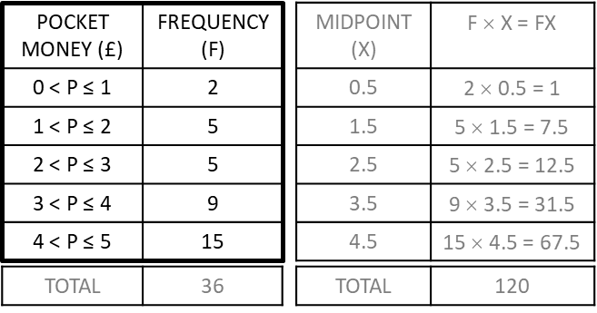
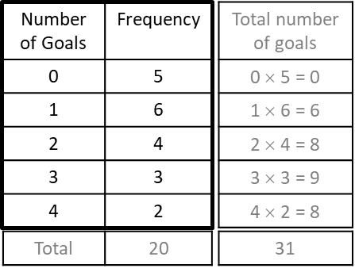
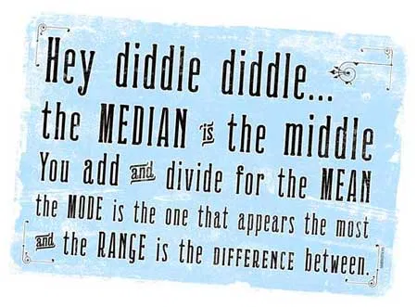
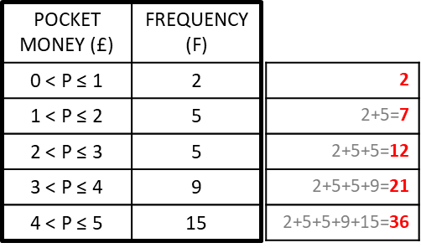
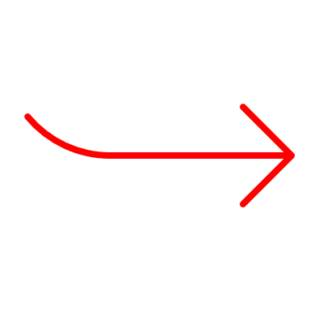
Year 7 Mathematics Knowledge Organiser – Representing data
KS4 Mathematics Knowledge Organiser – Percentages – Part 1
MEAN means the fair share (total of values ÷ number of values).
MEDIAN is the middle value when the values are put in order. AVERAGES
MODE is the most common value.
RANGE is the difference between the biggest and smallest values.
Frequency is the number of times an event happens.
Frequency table is a table for a set of observations showing how frequently each event occurs.
Grouped data is data grouped into non-overlapping classes or intervals.
Class is an interval for grouping data.
AVERAGES AND RANGE FROM LIST OF DATA
Example: Find all the averages and range from this list of data: 5, 6, 8, 9, 5, 8, 8, 7
Mean = total of values ÷ number of values
= (5 + 6 + 8 + 9 + 5 + 8 + 8 + 7) ÷ 8 = 56 ÷ 8 = 7
Mode (the most common value) = 8
Range = biggest – smallest value = 9 – 5 = 4
Median:
arrange data from the smallest to the biggest:
5, 5, 6, 7, 8, 8, 8, 9
2. find the middle value: 5, 5, 6, 7, 8, 8, 8, 9
the middle value is between 7 and 8
find mean of 7 and 8 = (7 + 8) ÷ 2 = 7.5
median = 7.5
Task1: Find mean, median, mode and range of these numbers: 9, 4, 9, 10, 13, 7, 11, 9
Task2: Choose 3 numbers with:
mean 6
mean 3 and range 4
mean 5 and median 3
AVERAGES FROM FREQUENCY TABLE
Example: A team plays 20 games, the coach records the number of goals they score in each game in a frequency table. Find averages and range.
AVERAGES FROM THE GROUPED DATA
Example: Find the estimate of mean, median and modal classes from the table below:
Mode: the most common number of goals is 1
(6 times in the table)
Mode = 1
Range: the highest value is 4 goals and the lowest 0 goals.
Range = 4 – 0 = 4
Modal class: 4 < P ≤ 5 (the most common class, 15 times)
Range: £5 – £0 = £5
Mean:
Create 3rd column (midpoint of the classes)
Create 4th column (midpoint × frequency)
Find total of frequencies and total of the 4th column.
Divide $\frac{total number of values (£)}{total frequencies}=\frac{120}{36}=$ £3.33
Median class:
Position of the median = $\frac{total frequency+1}{2}=\frac{36+1}{2}$ = 18.5th position
Mean:
Create the third column and multiply (value × frequency) to find the total number of values (goals)
Find total of frequencies and total of the 3rd column.
Divide $\frac{total number of values (goals)}{total frequencies}=\frac{31}{20}=1.55$
Median:
Work out the position of the median = $\frac{total frequency+1}{2}=\frac{20+1}{2}=$ 10.5th position
There are 5 ‘0 goals’ + 6 ‘1 goals’, which makes 11 values. The median is 10.5th value, median = 1.
(imagine values in a list: 0, 0, 0, 0, 0, 1, 1, 1, 1, 1, 1, 2…)
10.5th value
Median is 18.5th value, that is in median class 3 < P ≤ 4

Slide 2
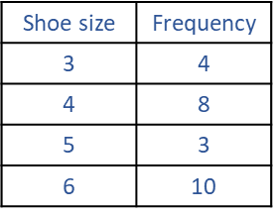
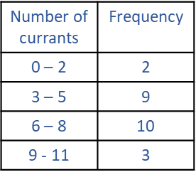
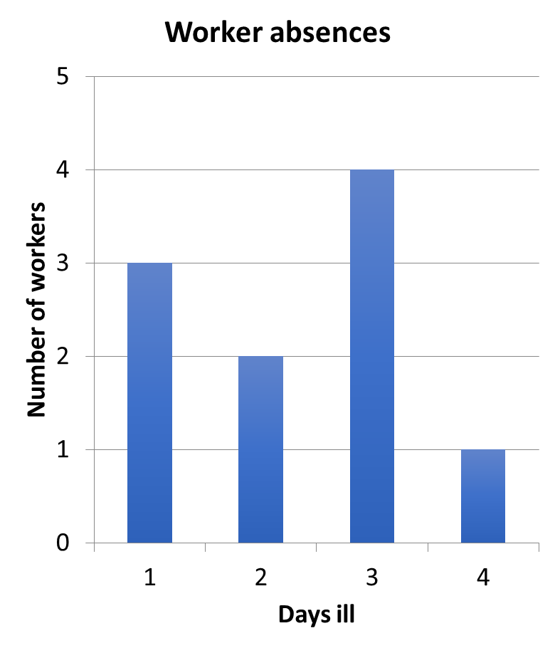
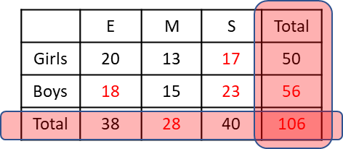
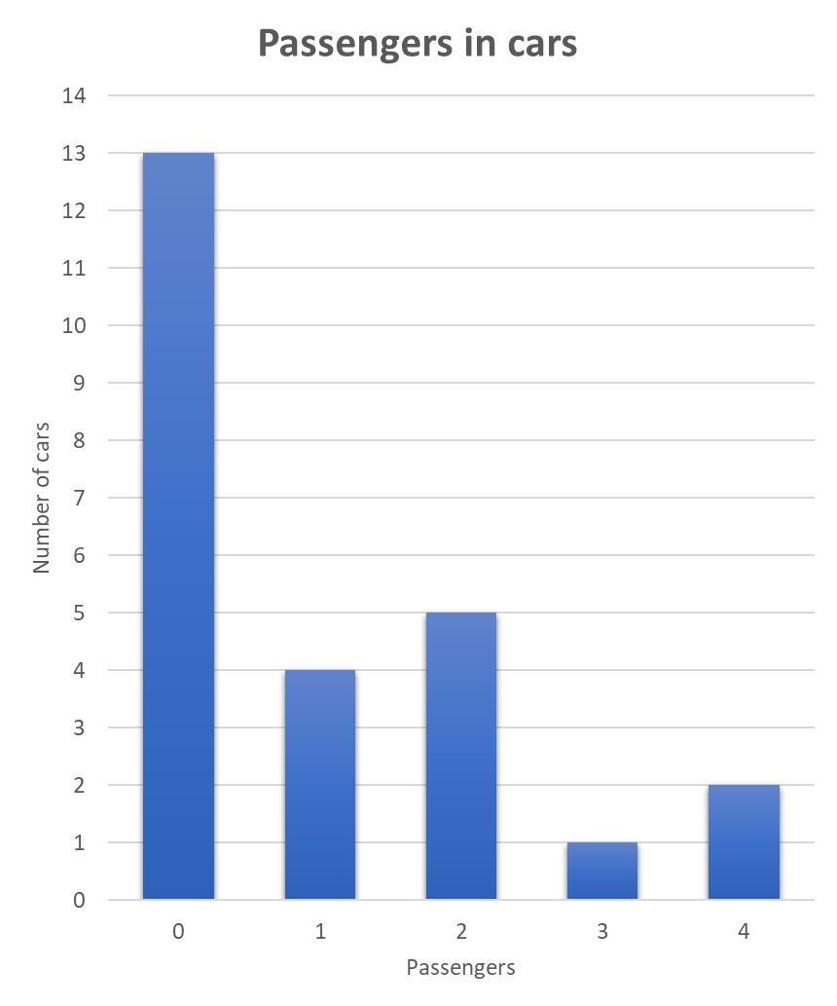
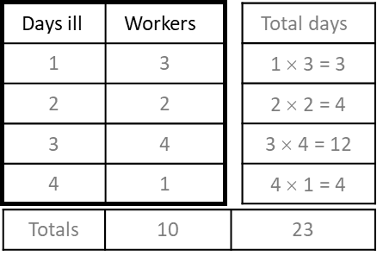
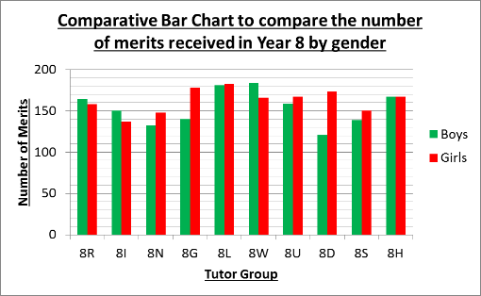
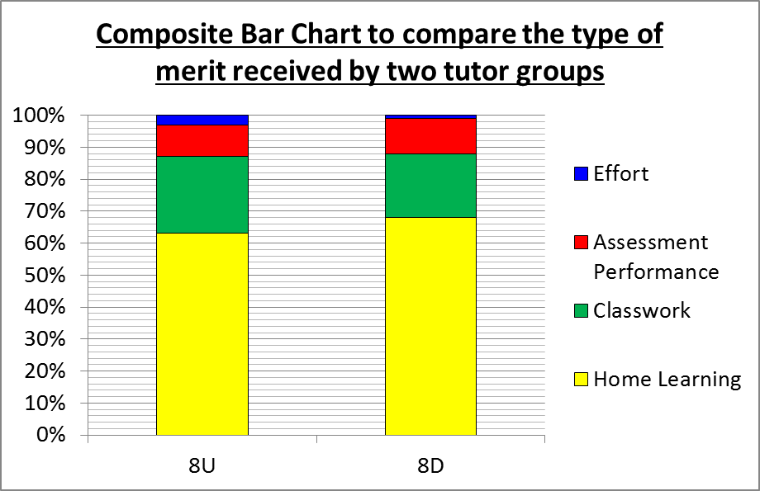
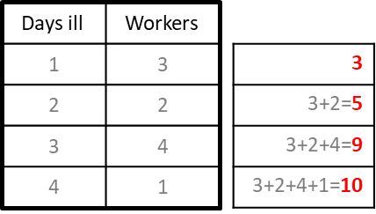
Year 7 Mathematics Knowledge Organiser – Representing data
KS4 Mathematics Knowledge Organiser – Averages – Part 2
KS4 Mathematics Knowledge Organiser – Percentages – Part 1
TWO-WAY TABLES
Data collected in two-way tables is divided into more than one category.
Example: Some college students were asked to choose which of the three subjects, English, Maths or Science they enjoyed the most. Complete the two-table below.
AVERAGES FROM BAR CHART
Example: Find mean, median, mode and range from this bar chart.
To find mean and median use the table:
Mean = $\frac{total number of values (day)}{total frequencies (workers)}=\frac{23}{10}=2.3$
Median:
the position of the median = $\frac{total frequency+1}{2}=\frac{10+1}{2}=$ 5.5th position
imagine values in a list: 1, 1, 1, 2, 2, 3, 3, 3, 3, 4
5.5th value lies between 2 and 3
or, 5.5th position is located between 2nd and 3rd row of the table
median = (2 + 3)÷2 = 2.5
Task3: Find mean, median, mode and range from these frequency tables:
a)
b)
Task4: Find mean, median, mode and range from this bar chart:
Mode is represented by the highest bar
Mode: = 3 days
Range = 4 - 1 = 3 days
the black numbers in the table are filled in from the text
the red numbers are added by calculation
BAR CHARTS
Bar charts represent statistical information. Bars, of equal width, represent frequencies by their height.
Comparative Bar Chart:
Bars for each category side-by-side
Gaps between each category
3a. Mean = 4.76
Median = 5
Mode = 6
Range = 3
3b. Mean = 5.75
Median = 6 - 8
Mode = 6 - 8
Range = 11
4. Mean =1
Median = 0
Mode = 0
Range = 4
Answers:
Mean = 9
Median = 9
Mode = 9
Range = 9
a) 5,6,7
b) 1,3,5
c) 3,3,9
Composite Bar Chart:
Bars show the size of individual categories split into their separate parts

Slide 3
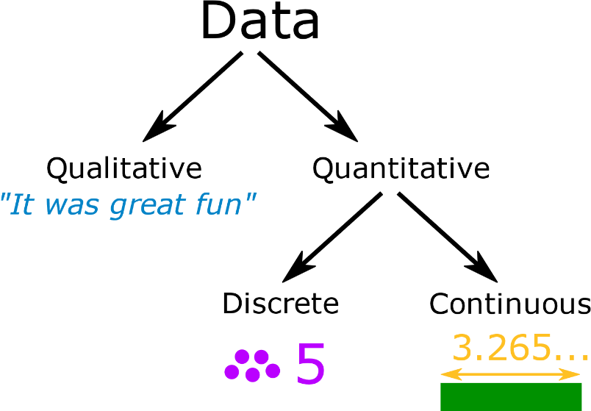
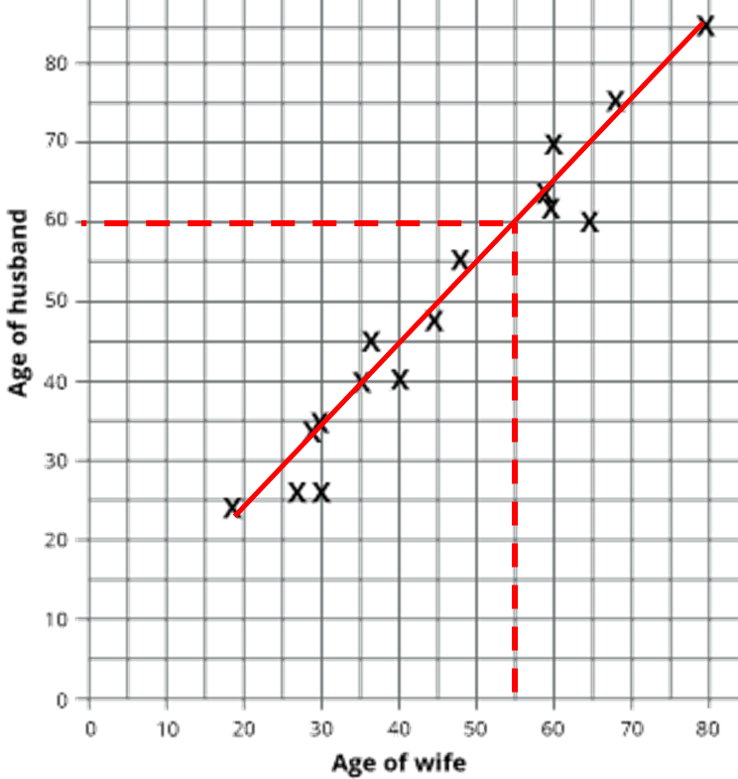
Year 7 Mathematics Knowledge Organiser – Representing data
KS4 Mathematics Knowledge Organiser – Percentages – Part 1
SCATTER GRAPHS
Scatter graph is a graph in which the values of two variables are plotted along two axes.
PIE CHARTS
A type of graph in which a circle is divided into sectors that each represent a proportion of the whole.
The sum of the angles in pie chart is 360 degrees.
LINE OF THE BEST FIT is a line drawn on a scatter graph to represent the best estimate of an linear relationship between the variables.
It should not go too much further beyond the outer points.
Temperature vs Ice creams sold
It does not have to run through the origin.
Approximately the same amount of points should be above and below the line.
Discrete data is counted, it can only take certain values.
Example: the number of students in a class
Continuous data is measured, it can take any value (within a range).
Example: a person's height.
Example: Create a pie chart from the table above.
You will always need to calculate the total for the frequency: 27 + 8 + 19 + 6 = 60
Calculate the angle that represents one item in the list by sharing 360 into total of the frequency: 360 ÷ 60 = 6 (means one car or bike or bus or other is represented by 6˚)
To calculate the angle of each category, multiply the frequency of the category by angle that represents one item only: for example angle for all cars = 27 cars × 6˚ = 162˚
Always check if your angles are correct by seeing if they add up to 360: 162 + 48 + 114 + 36 = 360˚
OUTLIER is an extreme value which is much higher or much lower than the rest of the values.
CORRELATION is a measure of the strength of the relationship between two variables.
Strong correlation implies close relationship (the points make a relatively straight line).
Weak correlation: the points are further apart from each other.
Example: Based on the scatter graph below, predict the age of the husband of a 55 year old woman.
Draw a line of the best fit.
Draw a line from number 55 on the x axis (age of wife axis) towards the line of the best fit.
Read the corresponding age of husband from y axis.
Answer: 60
Draw a pie chart using a protractor
Label the pie chart
Positive correlation: as one variable increases, so does the other. The line of the best fit has positive gradient (going uphill).
Negative correlation: as one quantity increases the other decreases. The line of the best fit has negative gradient (going downhill).

