Slide 1
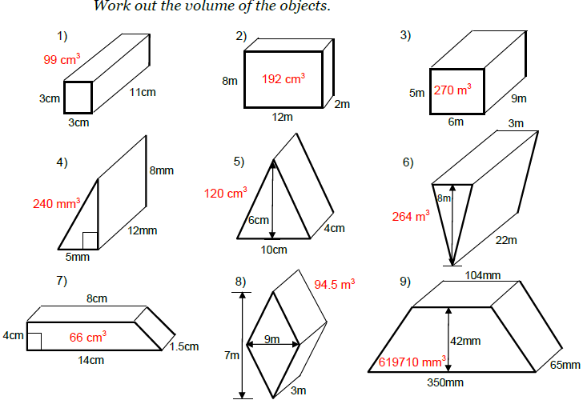
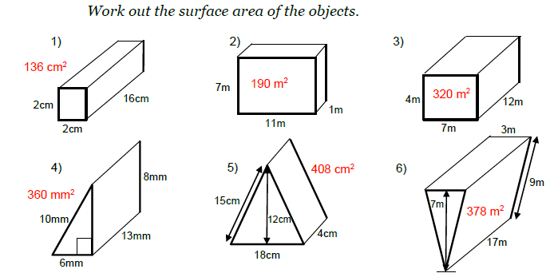
Volume and Surface Area
Year 8 Revision Booklet
Prime Factor Decomposition and HCF and LCM
Index form and Rules
Significant Figures
Estimation
Expanding and simplifying brackets
Substitution
Solving algebraic equations
Circles – area and circumference
Pythagoras
Volume of Prisms
16
1

Slide 2
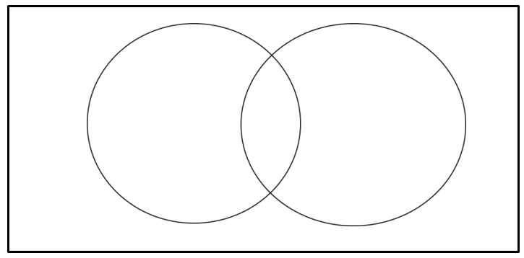
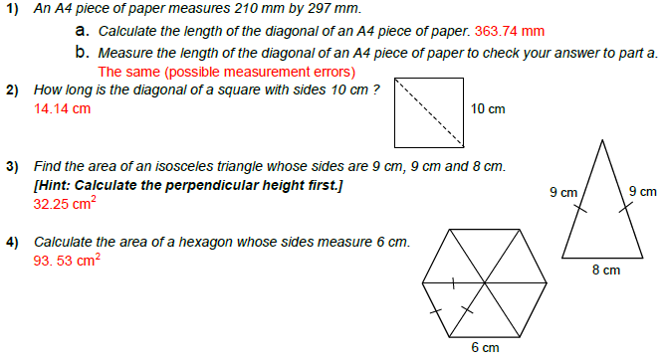
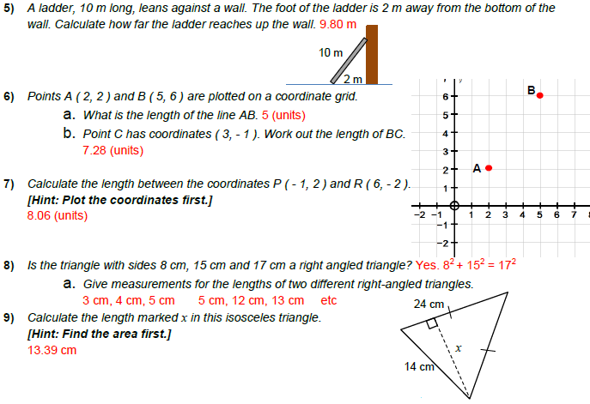
HCF and LCM
Pythagoras
20
30
30
20
2²x5
5
10
5
6
2
5
2
3
2
3
2
2
2x3x5
HCF = 5 x 2 =10
LCM = 5 x 2 x 2 x 3 = 60
12
28
28
2²x7
12
2²x3
2
6
2
14
3
2
2
7
2
7
2
3
HCF = 2 x 2 =4
LCM = 3 x 2 x 2 x 7 = 84
64
48
64
48
2
32
2
24
2
16
2⁶
3
2
2
2
2
12
2
8
2
2
2
6
2
2⁴x3
2
4
2
3
2
2
15
HCF = 2 x 2 x 2 x 2 =16
LCM = 2 x 2 x 2 x 2 x 2 x 2 x 3= 192
2

Slide 3
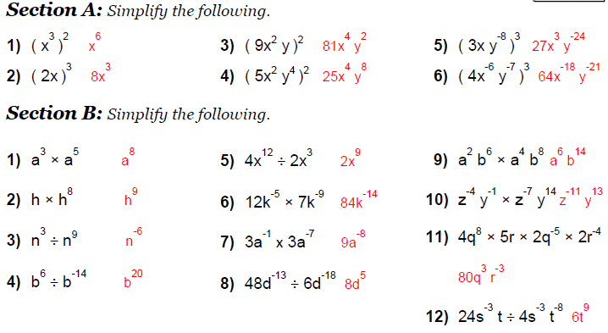
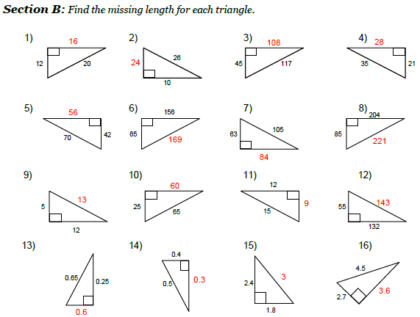
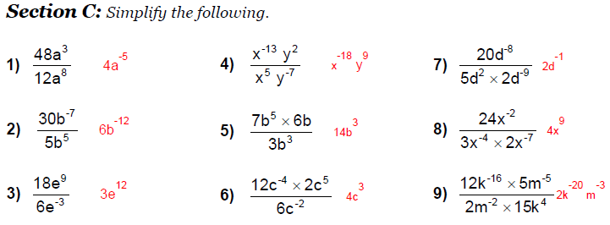
Pythagoras Problems
Indices – rules (Multiply / Divide)
14
3

Slide 4
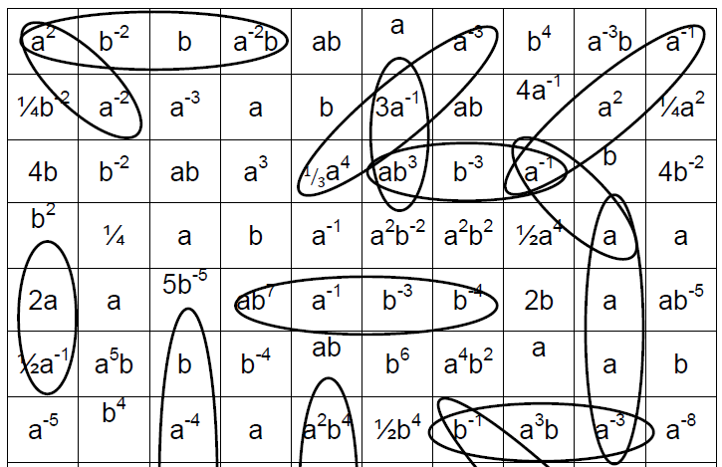
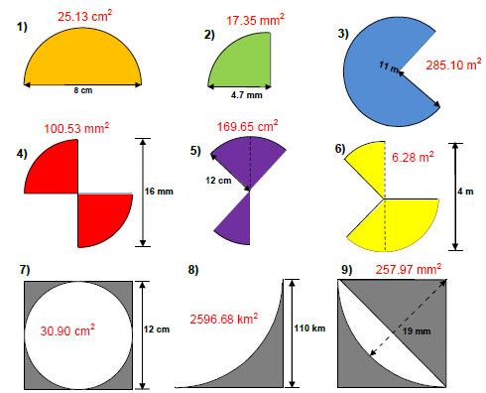
Indices – rules (to the power 0)
Circles – Sector Area Problems
4
13

Slide 5
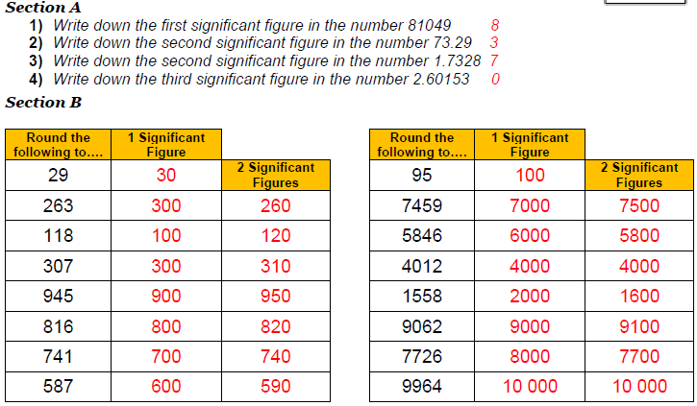
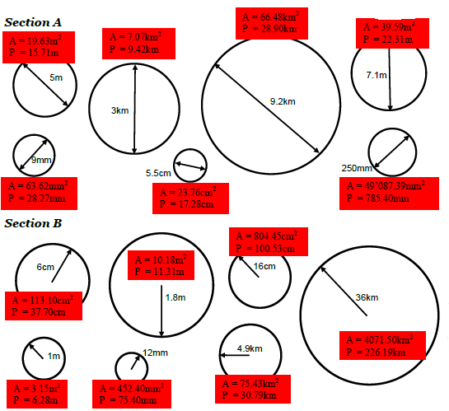
Significant Figures
12
5

Slide 6
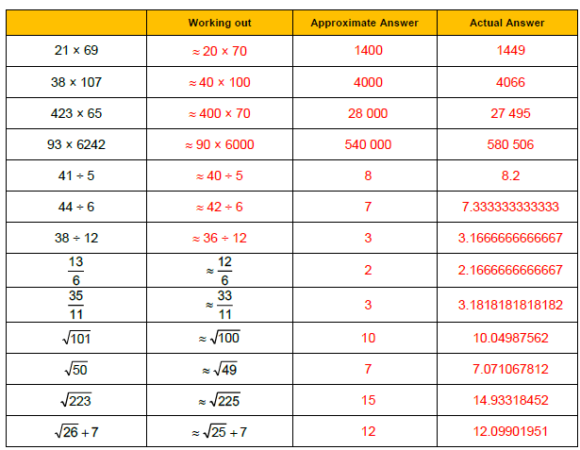
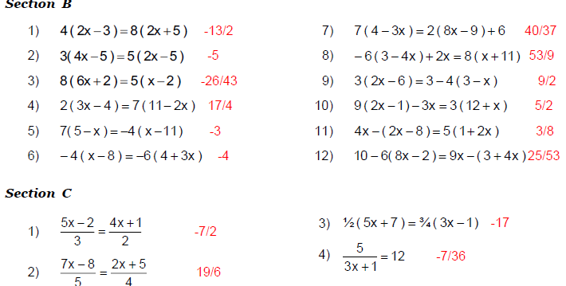
Estimation
Solving Equations
Remember estimation means round every number in the calculation to one significant figure if it is about multiplication, division, addition and subtraction.
If calculating a root work out which two whole numbers squared it is between and based on which one it is nearer give a reasonable guess including the first decimal place.
.0
.1
14.9
.1
6
11

Slide 7
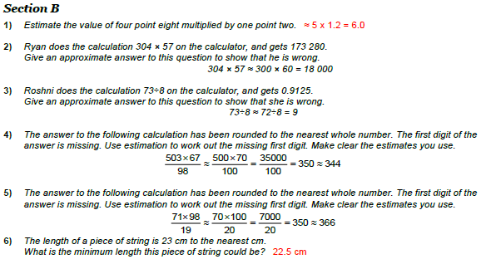
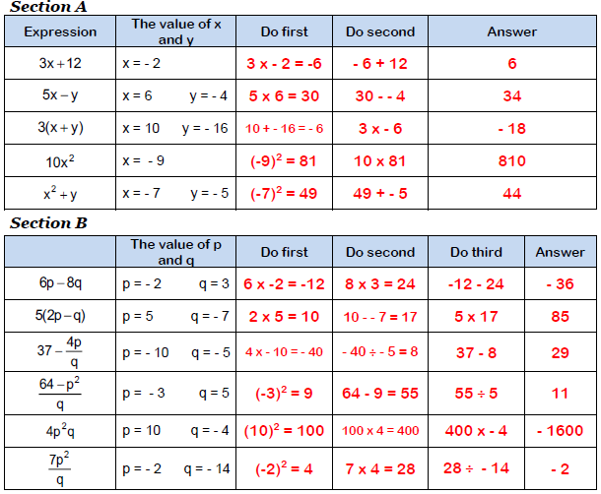
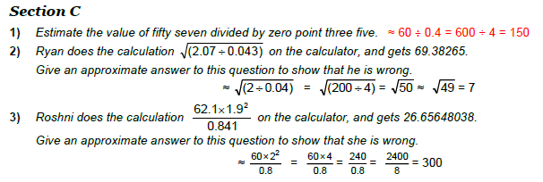
Estimation - Worded
Substitution
7
10

Slide 8
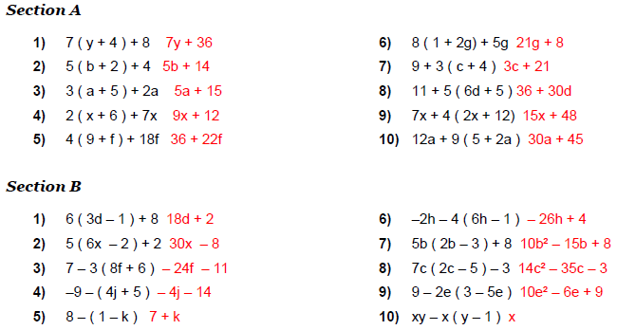
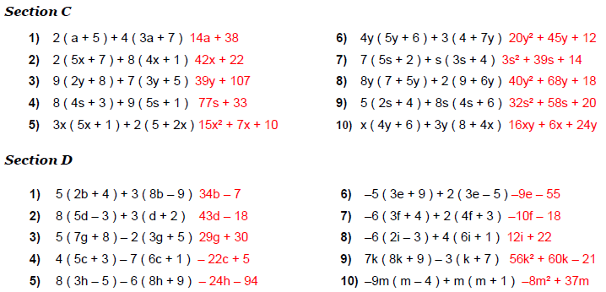
Expanding brackets and Simplifying
Expanding brackets and Simplifying
8
9

