Slide 1
Year 7 Mathematics Knowledge Organiser – Number skills
KS4 Mathematics Knowledge Organiser – Percentages – Part 1
Integer is any of the positive or negative whole numbers and zero. Example: ...-2, -1, 0, +1, +2 ...
Even number is an integer that is divisible by 2. Example: 2, 4, 6, 8, 10, 12, 14, …
Odd number is an integer that has a remainder of 1 when divided by 2. Example: 1, 3, 5, 7, 9, 11, 13, 15, …
Product is the result of multiplying one number by another.
Index notation is used as a shortcut for multiplication when a number is being multiplied by itself. Example: 5⁴ = 5 × 5 × 5 × 5
SQUARE NUMBERS
A square number is the result of multiplying integer by itself.
It is called a square number because it gives the area of a square whose side length is an integer.
CUBE NUMBERS
A cube number is the result of multiplying integer by itself, and by itself again.
It is called a cube number because it gives the volume of a cube whose side length is an integer.
ROOTS
A square root of a number is a value that, when multiplied by itself, gives the number.
Example: 4 × 4 = 16, so a square root of 16 is 4.
Notation for the square root is
The cube root of a number is a special value that, when used in a multiplication three times, gives that number.
Example: 3 × 3 × 3 = 27, so the cube root of 27 is 3.
Notation for the square root is $\sqrt[3]{}$
Example: Extension:
$\sqrt{81}$ = 9 $−\sqrt{81}$ = - 9
$\sqrt[3]{27}$ = 3 $\sqrt[3]{−27}$ = - 3
Notation of the square number: x²
Example: 3² = 3 × 3 = 9
Notation of the cube number: x³
Example: 5³ = 5 × 5 × 5 = 125
Note: It is impossible to find square root of a negative number, for example $\sqrt{−81}$.
x | 1 | 2 | 3 | 4 | 5 | 6 | 7 | 8 | 9 | 10 | 11 | 12
x² | 1 | 4 | 9 | 16 | 25 | 36 | 49 | 64 | 81 | 100 | 121 | 144
x³ | 1 | 8 | 27 | 64 | 125 | 216 | 343 | 512 | 729 | 1000 | 1331 | 1728
Answers:
49
125
6
2
49
-125
-6
-2
Task:
Evaluate
a) $7^{2}$
b) $5^{3}$
c) $\sqrt{36}$
d) $\sqrt[3]{8}$
Extension task:
Evaluate
e) ${(−7)}^{2}$
f) ${(−5)}^{3}$
g) $−\sqrt{36}$
h) $\sqrt[3]{−8}$
* You should remember the first twelve square numbers and the first five cube numbers.
Examples:
$4^{2}$ = 4 × 4 = 16
${\left(−4\right)}^{2}$= (-4) × (-4) = 16
${−4}^{2}$= - (4 × 4) = - 16
Examples:
$4^{3}$ = 4 × 4 × 4 = 64
${\left(−4\right)}^{3}$= (-4) × (-4) × (-4) = - 64
${−4}^{3}$= - (4 × 4 × 4) = - 64

Slide 2
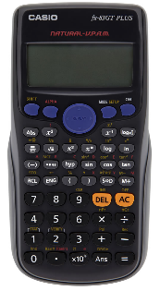
Year 7 Mathematics Knowledge Organiser – Number skills
KS3 Mathematics Knowledge Organiser – Numbers– Part 2
KS4 Mathematics Knowledge Organiser – Percentages – Part 1
KS4 Mathematics Knowledge Organiser – Percentages – Part 1
PRIME NUMBER
Prime numbers (not shaded numbers on the hundred square below) are whole numbers greater than 1 that have exactly two factors, themselves and 1.
Composite numbers (shaded numbers on the 100 square below) are integers that are divisible without remainder by at least one positive integer other than themselves and one.
FACTORS
Factors are numbers that divide another number without leaving a remainder.
Example:
Find factors of number 32
1 × 32
2 × 16
4 × 8
Factors of number 32 are: 1, 2, 4, 8, 16 and 32
LCM or The Lowest / Least Common Multiple
LCM is smallest positive number that is a multiple of two or more numbers.
Example:
Find the lowest common multiple of 6 and 9.
Multiples of 6 are: 6, 12, 18, 24, 30, 36…
Multiples of 9 are: 9, 18, 27, 36, 45, 54, …
Common multiples of 6 and 9 are: 18, 36 …
The LCM is 18
Task: Find factors of number 12
Answer: 1, 2, 3, 4, 6, 12
HCF or the Highest Common Factor
HCF is the greatest number that is a factor of two (or more) other numbers.
USING CALCULATOR
To work out 34²:
Enter 34
Press the x² button
Press =
You should get the answer 1156
$$x^{2}$$
Example:
Find the highest common factor of 18 and 24.
Factors of 18 are: 1, 2, 3, 6, 9, 18
Factors of 24 are: 1, 2, 3, 4, 6, 8, 12, 24
Common factors of 18 and 24 are: 1, 2, 3 and 6
The HCF is 6
To work out 26³:
Enter 26
Press the x³ button
Press =
You should get the answer 17576
$$=$$
$$x^{3}$$
$$=$$
Example:
15 is divisible by 1, 15, 3, 5, therefore it is not a prime number.
2 is divisible by 1 and 2 only, therefore it is a prime number (the only even prime number)
Important note: Number 1 is not prime nor composite number.
Prime numbers that you should remember are: 2, 3, 5, 7, 11, 13, 17, 19, 23, 29
Task: Find the HCF and LCM of 12 and 15
Answers:
Multiples of 12 are: 12, 24, 36, 48, 60, 72…
Multiples of 15 are: 15, 30, 45, 60, 75…
The LCM is 60
Factors of 12 are: 1, 2, 3, 4, 6, 12
Factors of 15 are: 1, 3, 5, 15
The HCF is 3
To work out $\sqrt[3]{2197}$:
Press SHIFT
Press the $\sqrt{■}$ button
Enter 2197
Press =
You should get the answer 13
To work out $\sqrt{225}$:
Press the $\sqrt{■}$ button
Enter 225
Press =
You should get the answer 15
$$\sqrt{∎}$$
$$\sqrt{∎}$$
$$=$$
$$=$$

Slide 3
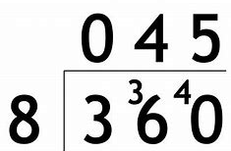
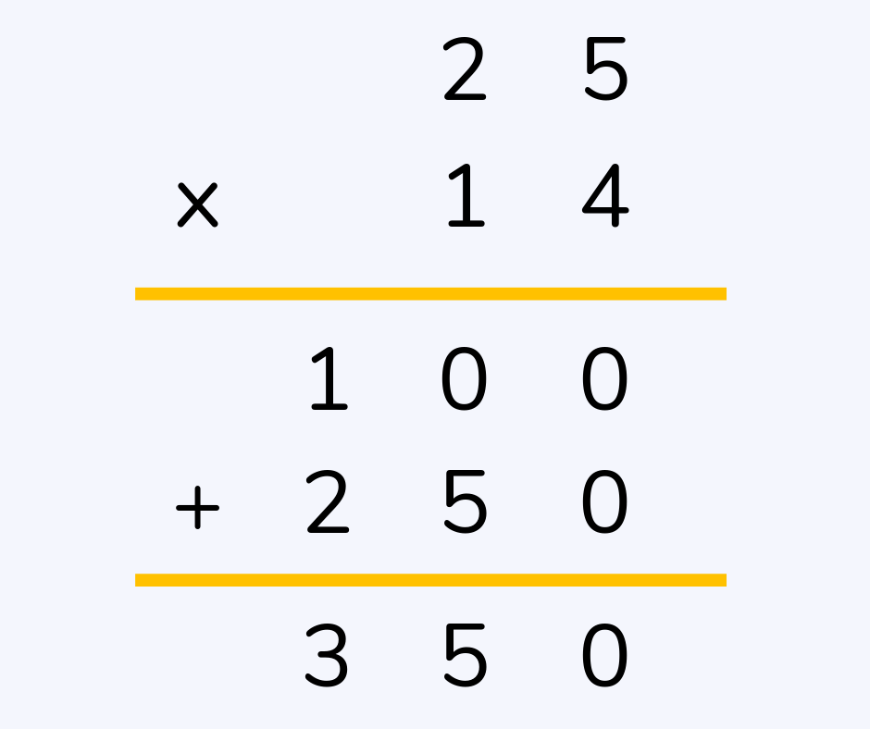
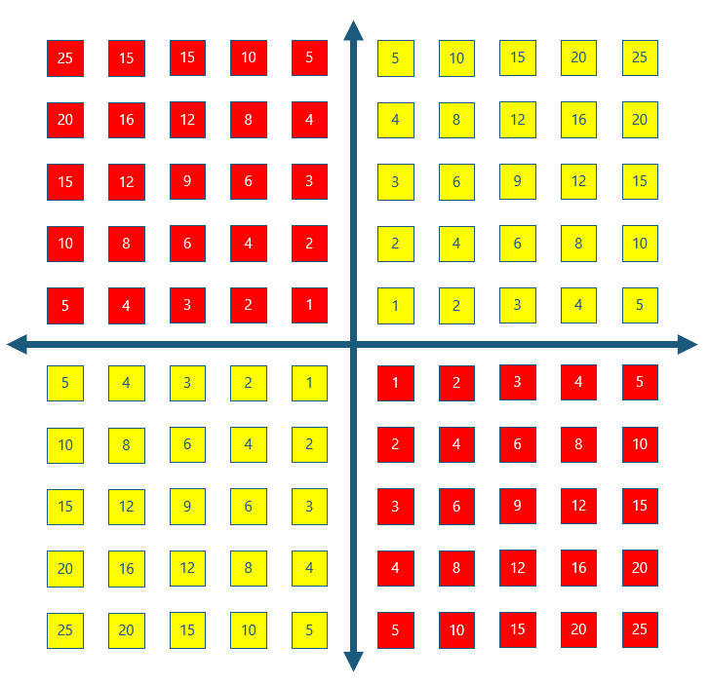
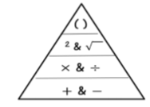
Year 7 Mathematics Knowledge Organiser – Number skills
DIRECTED NUMBER
DIVISION
To divide two numbers, we use the bus stop method.
Short division Long division
One of the methods which can help you to solve calculation with negative numbers, is a number line
= 28.8
$$\left(−8\right)+4=−4$$
$$5−6=−1$$
Second method is using counters.
1
1
1
1
1
1
1
This represents $7+(−5)$
-1
-1
-1
-1
-1
There are five zero pairs.
Removing the zero pairs leaves us with 2.
Therefore: $7+\left(−5\right)=2$
zero pairs
MULTIPLICATION
To multiply two numbers together, the grid method is useful to ensure that the calculation is completed correctly.
The second method to use is column method.
This leads us to realise that $7+\left(−5\right)$ gives the same answer as $7−5.$
So 7 – 5 = 7 + (-5)
Consequently also 7 – (-5) = 7 + (+5) = 7 + 5
The subtraction symbol ‘–’ means addition of the ‘additive inverse’
900
720
63
900 + 720 + 63 = 1683
MULTIPLICATION AND DIVISION OF DIRECTED NUMBERS
× or ÷ of positive numbers gives POSITIVE answer
Example: 2 × 3 = 6
× or ÷ of positive AND negative numbers gives NEGATIVE answer
Example: or
× or ÷ of negative numbers gives POSITIVE answer
Example:
BIDMAS
The order in which we complete operations in a sum is important.
If operations of the same priority are in the same sum, we work from left to right
Example: 10 – 3 + 5 = 12,
first 10 – 3 = 7,
then 7 + 5 = 12.
2
1
$$3×\left(−2\right)=−6$$
$\left(−6\right)÷3=−$2
3
2
$$(−6)÷\left(−2\right)=3$$

